Slide 1

MOCEAN
TEAM 5.05
Better wearable data. Better informed treatments.
May 16, 2021

Slide 2
Some basic facts…
TEAM 5.05
More than 10 million people worldwide are living with Parkinson disease (PD).
PD is the second-most common neurodegenerative disease.
Incidence of PD increases with age.
- https://www.parkinson.org/Understanding-Parkinsons/Statistics

Slide 3
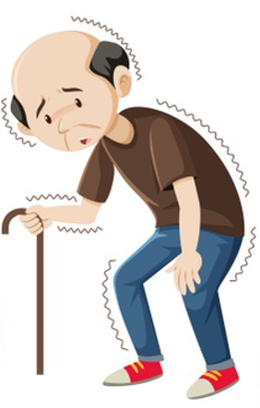
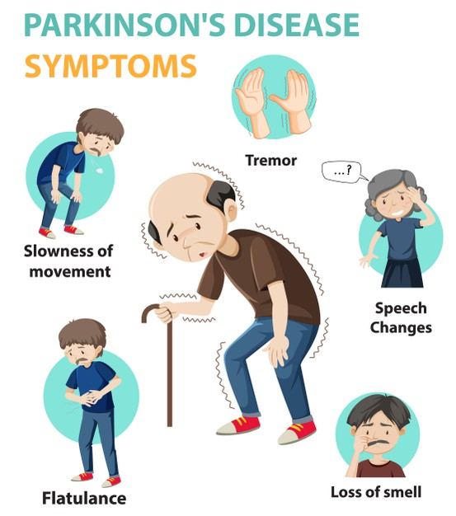
Why is tracking movement important?
TEAM 5.05
People living with Parkinson disease (PD) experience mobility issues as their disease progresses.
Tremor
Loss of balance
Slowness of movement

Slide 4
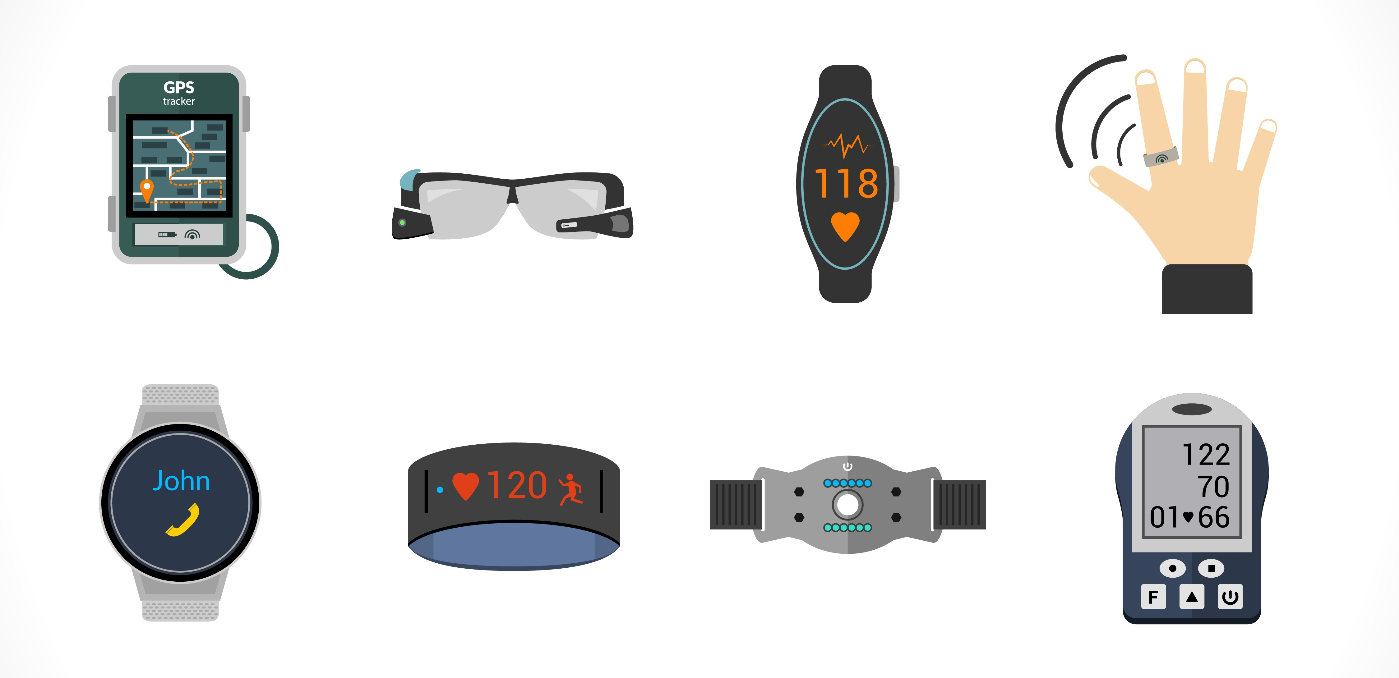
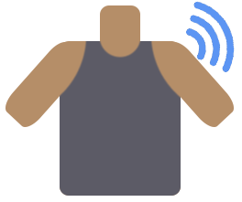

How do wearables fit into all this?
TEAM 5.05
Tracking mobility can help a person stay in one's home and to communicate with a nurse clinician or nurse care manager.
THE GOOD
Many commercially available wearable devices already gather this data!
THE BAD
Can be difficult to put on or take off.
Can be “hot” and uncomfortable to wear.
People living with PD (PwP) prefer non-obtrusive wearables (Bloem, 2020)
Reference: Bloem, B. et al (2020). Integrated and patient-centred management of Parkinson’s disease: a network model for reshaping chronic neurological care. The Lancet. 19 (7), 623-634.

Slide 5
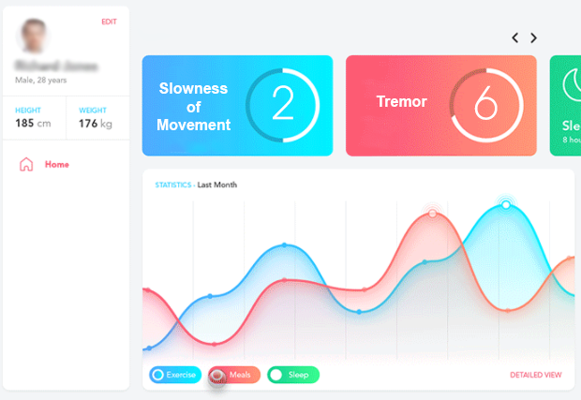
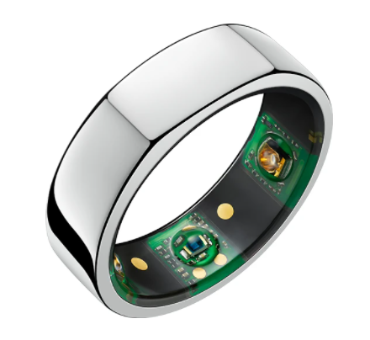

Meet Mocean
TEAM 5.05
An ecosystem that bridges the gap of existing wearables technology and informed patient-centric treatments and decisions by literally reading between the lines.
Analyzes ALL movement data
Summarizes Parkinson disease-related episodes in an easy-to-read-dashboard
Allows simple Bluetooth data upload even in the absence of network connectivity – making it ideal for rural areas.
Assists in making the clinical decisions necessary to slow disease progression.
NON-OBTRUSIVE DEVICE INTEGRATION
https://medicalxpress.com/news/2021-02-smartwatch-parkinson-disease.html
AUGMENTS CLINICAL DECISIONS
COST-EFFECTIVE

Slide 6

What will it cost?
TEAM 5.05
Device cost initially incurred by either patient or biopharma seeking to introduce new drug to market.
Expands to insurance coverage over time.
Market opportunities
Partnership with nurse clinicians and home health aide provider companies and provincial governments in Canada
Potential improvement activity under Merit-based Incentive Payment Systems (MIPS – U.S. based) to reduce hospital use and improve mental health services. i.e. anxiety, depression, psychosis
Material: | Cost
Ring (Depends on Metallic) | $299 USD/user
Initial Application Development | $10,000-$20,000/USD
Server Maintenance | ~$50/100 users/USD

Slide 7




But will it scale?
TEAM 5.05
10 million PwP globally
Expand existing market footprint through product offerings
Apply product methodology to other neurological conditions
YES!
It will scale

Slide 8
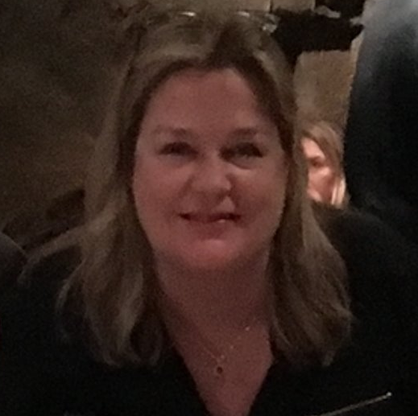


Meet the Team
TEAM 5.05
Gigi van den Hoef
Ben Zheng
Jay Sturm
As a nurse clinician and researcher, Gigi became involved with people living with Parkinson disease (PwP). Seeing the need to improve the quality of care for PwP in the community, in 2016, she started the Canadian Nurses for Parkinson disease network bridging movement disorder clinics, hospital nurse clinicians and community nurse clinicians and companies.
As a supply chain practitioner, Ben has been involved in implementing technology projects at J&J VisionCare. Prior, Ben worked in implementing technology solutions at Allergan and Cardinal Health. Ben has a bachelors in Chemical Biology and Economics from UC Berkeley.
An IT professional since 2004, Jay has a strong background in process design & improvement and digital transformation – particularly in the healthcare IT space. Previous roles include VP of Operations for an EHR software company and Deputy CIO of Bellevue Hospital in New York City.

Slide 9
Questions
TEAM 5.05

